Slide 1
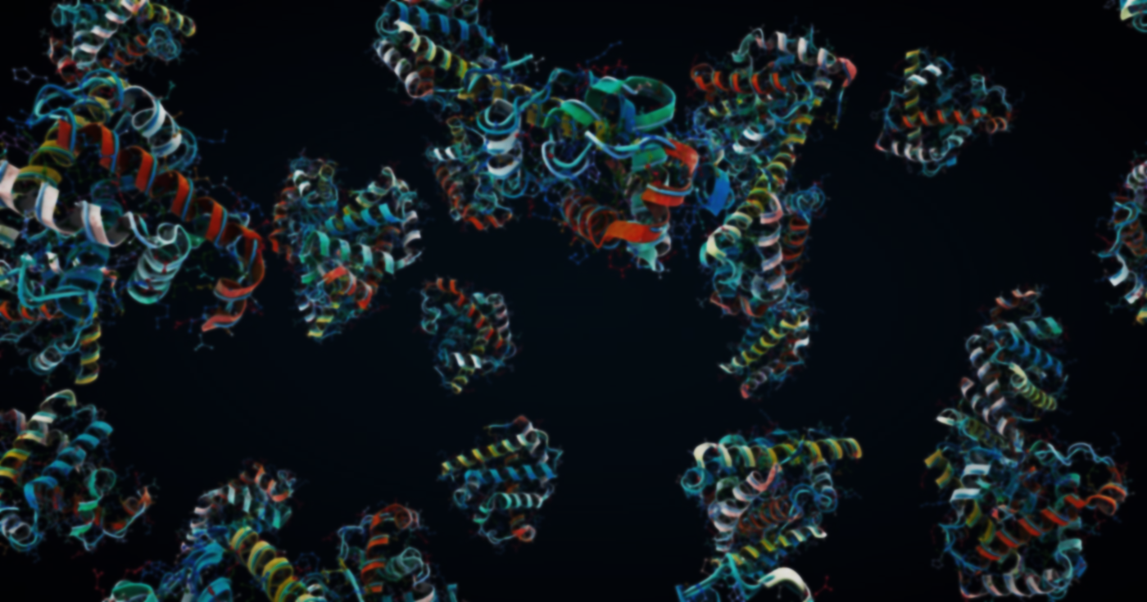
All-Atom Novel Protein Sequence Generation
Using discrete diffusion

Slide 2
What are proteins & Why design proteins?
Workhorses of all living organisms
Regulate our bodies systems
Why design these proteins
Specialized enzymes speed up break down materials
Specialized medicines for new viruses
COVID-19
Hormones & enzymes
Antibodies
Fight diseases
Plastics
Notes:
Proteins are the workhorses of all living organisms
Help regulate our bodies systems as hormones and enzymes can give support as collagen or fight diseases as antibodies
Why design these proteins
Help speed up chemical reactions in factories
Targeted enzymes that could help break down materials such as plastics
Help fight diseases as targeted medicine
Specialized antibodies that can bind to viruses such as COVID-19

Slide 3
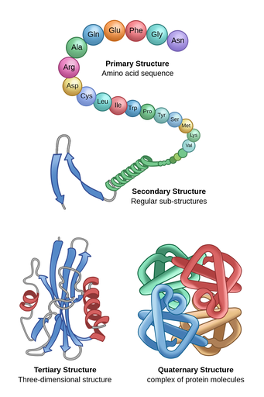
How to design proteins?
Protein is a long chain of amino acids
20 standard amino acids
Protein “folds” into a large complex 3D structure
Each amino acid is unique
Structure gives a proteins function
Notes:
Protein is a large macro-molecule composed of a long chain of amino acids
These amino acids are linked together using peptide bonds
The order of the amino acids thus describes this protein
Most organisms use 20 different amino acids
When the protein is created it “folds” into a large complex 3-dimensional structure
This structure ends up determining the protein’s function
Each amino acid is unique and in the sequence it influences how the structure bends and twists in the final structure
The shape of the structure results in its specific function in our bodies
Small changes in sequence can have large effects in structure and function

Slide 4
How to represent proteins?
Sequence of letters
…MSTDMAG…
Coordinates of 3D structure
(x,y,z)
Notes:
We can design proteins based on its
Sequence using the amino acid representation using 20 different letters
example: …MSTDMAG…
Structure using its 3-dimensional structure using coordinates
example
Or using both!

Slide 5
Why use only a protein’s sequence?
Sequence-to-structure models
Start at source
Data quality & availability
Notes:
Recent research has made it possible to obtain a proteins structure from its sequence
Allowing us to focus on only creating the sequence
Sequence gives structure gives function
So, start at the source
Far more data for protein sequences than protein structures
Data that is there is not perfect
A protein’s structure changes. From miniscule vibrations to big shape shifts depending on its location and situation
Protein structures are captured as a static snapshot, like they're frozen in time. Measuring these structures in labs takes a lot of time and resources.

Slide 6

We need to be more expressive
Rare amino acids other than standard
canonical vs. non-canonical
Inefficient
Changes happen after creation
amino acids or proteins
Insulin
Can we go beyond the 20 amino acids?
Notes:
Rare amino acids exist outside the 20 standard amino acids (canonical vs non-canonical)
Example: using more amino acids can lead to new breakthroughs
Adding more to our list is inefficient because there are a lot of rare amino acids to account for
After a proteins creation, the protein or amino acids can be changed (PTMs) changing it structure and its function.
Example: insulin has PTMs which is used to regulate our metabolism
We cannot represent this change by using a sequence of the 20 amino acids

Slide 7
All-Atom Protein Representation
Canonical and non-canonical
Include changes
Amino acids or proteins
Using atoms of amino acids
Create a long chain of atoms
Use any amino acid we want

Slide 8

What is a diffusion model?
Diffusion model
Notes:
Compared to other models they
Can generate more diverse data
Can generate more qualitative data
Take more time and computing power

Slide 9
Why a diffusion model?
Other models
Notes:
Compared to other models they
Can generate more diverse data
Can generate more qualitative data
Take more time and computing power

Slide 10
Why a diffusion model?
Diffusion model
Notes:
Compared to other models they
Can generate more diverse data
Can generate more qualitative data
Take more time and computing power

Slide 11
Why a diffusion model?
Other models
Notes:
Compared to other models they
Can generate more diverse data
Can generate more qualitative data
Take more time and computing power

Slide 12
Why a diffusion model?
Diffusion model
Notes:
Compared to other models they
Can generate more diverse data
Can generate more qualitative data
Take more time and computing power

Slide 13
Why a diffusion model?
Diffusion model
Notes:
Compared to other models they
Can generate more diverse data
Can generate more qualitative data
Take more time and computing power

Slide 14




Why discrete?
Continuous diffusion
Smooth transitions between values
Values have an order
Discrete diffusion
No transitions between values
No order

Slide 15
Why discrete?
Continuous diffusion
Smooth transitions between values
Values have an order
Discrete diffusion
No transitions between values
No order

Slide 16
Background
Diffusion, Architecture & All-atom

Slide 17
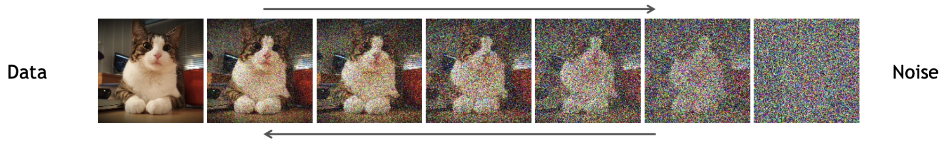
How does a diffusion model learn?
Slowly add noise during forward pass
Learn how to remove this noise during backward pass

Slide 18



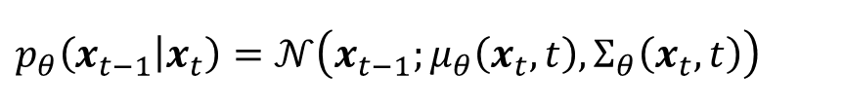
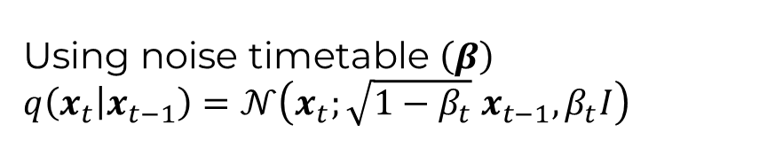
Denoising Diffusion Probabilistic Model (DDPM)¹
Forward pass takes $T$ timesteps
Forward pass takes 𝑇 timesteps
Backward pass uses neural network $\left(θ\right)$
Backward pass uses neural network (𝜃)
Markovian process
Only last timestep influences current timestep
Using noise timetable $\left(β\right)$
$$q\left(x_{t} | x_{t−1}\right)=𝒩\left(x_{t};\sqrt{1−β_{t}}{ x}_{t−1}, β_{t}I\right)$$
$$p_{θ}\left(x_{t−1} | x_{t}\right)=𝒩\left(x_{t−1};μ_{θ}\left(x_{t},t\right), Σ_{θ}\left(x_{t},t\right)\right)$$
Notes:
Forward pass adds noise over $T$ time steps until we arrive at complete noise
Done over $T$ time steps using a noise timetable $\left(β\right)$
$q\left(x_{t} | x_{t−1}\right)=𝒩\left(x_{t};\sqrt{1−β_{t}}{ x}_{t}, β_{t}I\right)$
Backward pass has a neural network $\left(θ\right)$ that learns to remove this noise
$$p_{θ}\left(x_{t−1} | x_{t}\right)=𝒩\left(x_{t−1};μ_{θ}\left(x_{t},t\right), Σ_{θ}\left(x_{t},t\right)\right)$$
We use a Markovian process, only the last timestep influences the current timestep

Slide 19
What is important for our noise?
$$q\left(x_{t} | x_{0}\right)$$
𝑞(𝒙_𝑡│𝒙_0 )
Quickly calculate noise for any $t$
Quickly calculate noise for any 𝑡
$$q\left(x_{t−1} | x_{t},x_{0}\right)$$
𝑞(𝒙_(𝑡−1)│𝒙_𝑡,𝒙_0 )
Calculate the solution for posterior
Used in the loss function
Notes:
We select noise carefully so that we can easily calculate:
$q\left(x_{t} | x_{0}\right)$: the needed amount of noise for any timestep $t$
$q\left(x_{t−1} | x_{t},x_{0}\right)$: called the posterior which is an important value because it allows our neural network to learn

Slide 20



Discrete DDPM (D3PM)
Noise:
chance of going from one category to another

Slide 21
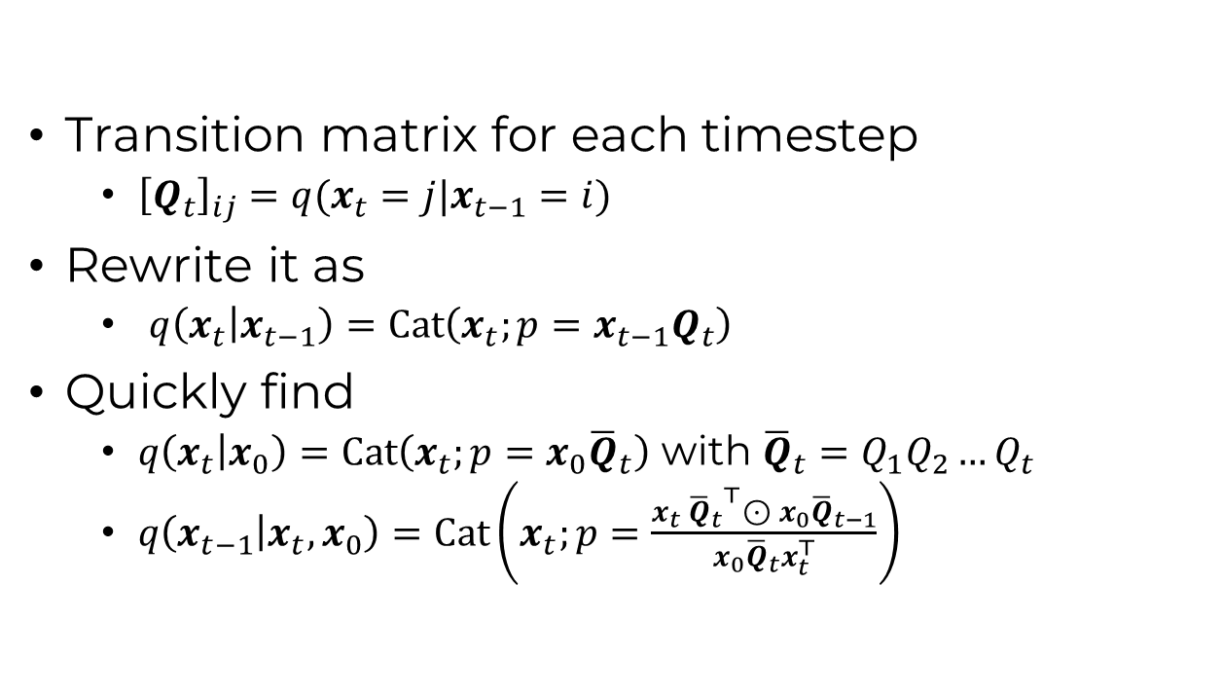
Discrete DDPM (D3PM)¹
Transition matrix for each timestep
  ${\left[Q_{t}\right]}_{ij}=q(x_{t}=j|x_{t−1}=i)$
Rewrite it as
  $q\left(x_{t} | x_{t−1}\right)=Cat\left(x_{t};p=x_{t−1}Q_{t}\right)$
Quickly find
  $q\left(x_{t} | x_{0}\right)=Cat\left(x_{t};p=x_{0}{\overline{Q}}_{t}\right)$ with ${\overline{Q}}_{t}=Q_{1}Q_{2}…Q_{t}$
  $q\left(x_{t−1} | x_{t},x_{0}\right)=Cat\left(x_{t};p=\frac{x_{t} {{\overline{Q}}_{t}}^{⊤}⊙{ x}_{0}{\overline{Q}}_{t−1}}{x_{0}{\overline{Q}}_{t}x_{t}^{⊤}}\right)$
 | 0.6 | 0.2 | 0.2
 | 0.2 | 0.6 | 0.2
 | 0.2 | 0.2 | 0.6
Notes:
One hot encode and use a categorical distribution
Stack matrices
Use bayes rule

Slide 22









Uniform:
Absorbing:
 | 0.6 | 0.2 | 0.2
 | 0.2 | 0.6 | 0.2
 | 0.2 | 0.2 | 0.6
 |  |  |  | #
 | 0.6 | 0 | 0 | 0.4
 | 0 | 0.6 | 0 | 0.4
 | 0 | 0 | 0.6 | 0.4
# | 0 | 0 | 0 | 1
$x_{0}$:
$x_{0}$:
$x_{t}$:
$x_{t}$:
#
#
$x_{t+1}$:
$x_{t+1}$:
#
#
#
Notes:
We can change back for uniform, we can go from any state to another
We cannot go back for absorbing, once we are in absorbing we cannot come back

Slide 23
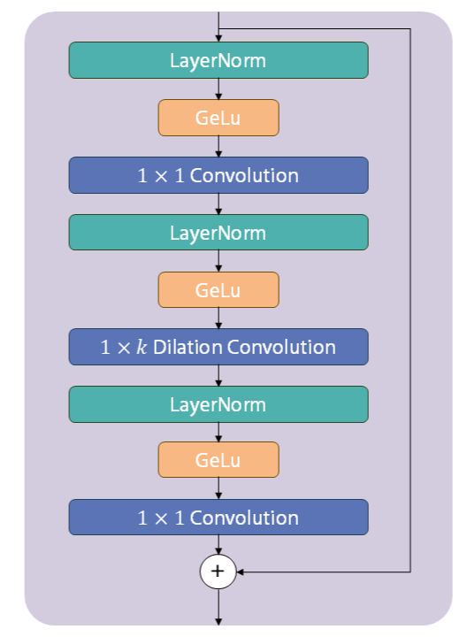
ByteNet Architecture
Sequence-to-sequence convolutional neural network
Competitive results for protein sequences
Long range dependencies
Efficient due parallelization
Notes:
More efficient because of convolutions

Slide 24
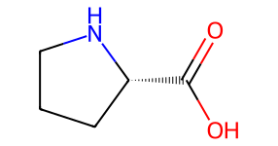
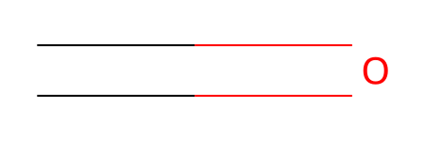
How to create sequences of atoms
A molecule has branches and rings
SELF-referencing embedded strings (SELFIES)¹
Always corresponds to correct molecule
[C][C][C@H1][Branch1][Branch1][N][C]
[Ring1][Branch1][C][=Branch1][C][=O][O]
[C][=O][C][N][O]:
Notes:
A molecule has branches and rings
How can we show that with a linear sequence
SELF-referencing embedded strings (SELFIES)
Designed for generative models
Always corresponds to a correct molecule
SELFIES sees how many bonds we have left in our molecule and will not use the last tokens if there are no more bonds available
Useful because we do not have to validate our generated molecules

Slide 25
Related work
All-atom & discrete diffusion

Slide 26
All-atom sequence generation
One previous work¹ used all-atom for protein generation
Generate canonical & non-canonical amino acids
GPT approach
No detailed analysis
Other work on smaller molecules² and polymers³
Notes:
No detailed analysis of how & why generated molecules are marked as proteins

Slide 27
All-atom protein structure generation
Co-design of sequence & structure^{1,2,3}
Complete or partial structure by all-atom location in 3D space
Sequence by amino acids
Diffusion or language models
Design of structure⁴
Part of structure by all-atom location in 3D space
Interacting molecules^{5,6}
Interacting molecules by all atom
Sequence by amino acids
Notes:
Hayes2024simulating
Generates proteins using sequence, structure and function information
Complete structure is given by each atom location in 3D space
Sequence given by amino acids
Chu2024all & Liu2024all
Uses diffusion model with both sequence and structure information
Part of structure is given by the atom location in 3D space
Sequence given by amino acids
Anand2019fully
Part of structure is given by the atom location in 3D space
Krishna2024generalized & Abramson2024accurate
Represent interacting molecules using all atom

Slide 28
Discrete diffusion in protein design
Discrete diffusion on amino acid sequence¹
Uses D3PM & other models
Combination of continuous and discrete^{2,3}
Interacting molecules or proteins
Guided discrete diffusion for sequence generation⁴
Part of the generation process
Evolutionary informed noise
Notes:
Alamdari2023protein (evodiff)
Uses discrete diffusion to generate amino acid sequences
Lin2024functional
Uses a combination of discrete and continuous diffusion to generated interacting molecules
Campbell2024generative
Uses a combination of discrete and continuous diffusion to generate a proteins sequence and structure
Gruver2024protein
Uses a guided discrete diffusion process to generate amino acid sequences

Slide 29
Research questions

Slide 30
Question?
What is the quality of the generated proteins from an all-atom model using a discrete diffusion process?
How does an all-atom representation impact the uniqueness, diversity, and structural correctness of generated protein sequences compared to the traditional amino acid-level representation using discrete diffusion?
What are the effects of applying different noise schedules—specifically uniform and absorbing—on the ability of discrete diffusion models to generate protein sequences?

Slide 31
Method
Dataset, atom- & protein-level evaluation

Slide 32
Dataset
UniRef50
Filter out unknowns
Filter out small and long sequences
Groups similar sequences
Notes:
We use the protein sequences from UniRef50
Large database which groups sequences which are a 50% match
This gives a balance between using still having a large amount of sequences which are still diverse but unique
We filter out any sequence with unknowns and non-canonical amino acids
We cannot create an all-atom representation from unknowns and non-canonical
We filter out small and long sequences
Small proteins are a-typical
SELFIES multiplies sequence length by a factor of ±19
Longer sequences means longer training times

Slide 33
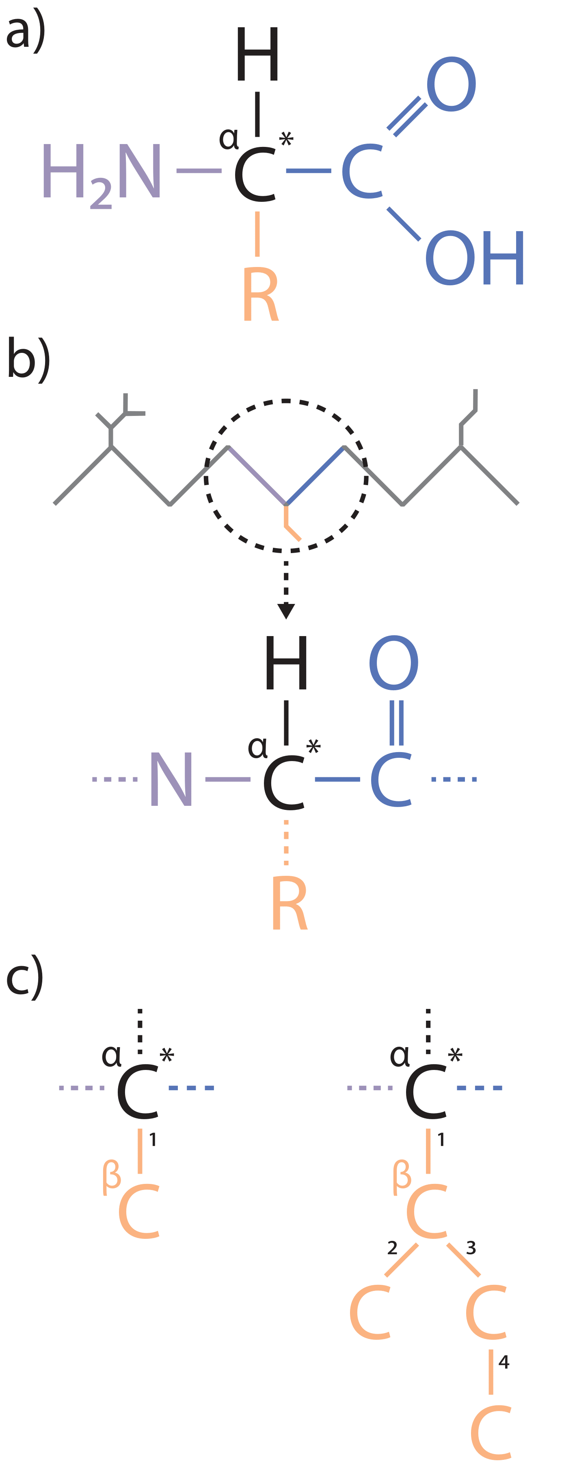
Atom-level evaluation
Amino acid have different sidechains (R)
Bind together with peptide bonds
From bonds we find:
  Continuous backbone
  Beginning of sidechain
Notes:
If we do not find a peptide bond or a continuous backbone, we do not have a protein

Slide 34
Atom-level evaluation
Graph traverse over sidechain
Sidechain must start with carbon
  Known amino acids all start with carbon
We find an amino acid
Notes:
Explain alpha and beta carbon
Except glycine which does not have a sidechain

Slide 35
Atom-level evaluation
We compare with canonical amino acids
Check for stereochemistry?
  Only one type used by organisms
We construct a sequence
  Unknown amino acids are marked ‘X’
Check for extra atoms
  Beginning or end of backbone
Notes:
Explain chirality and stereochemistry

Slide 36
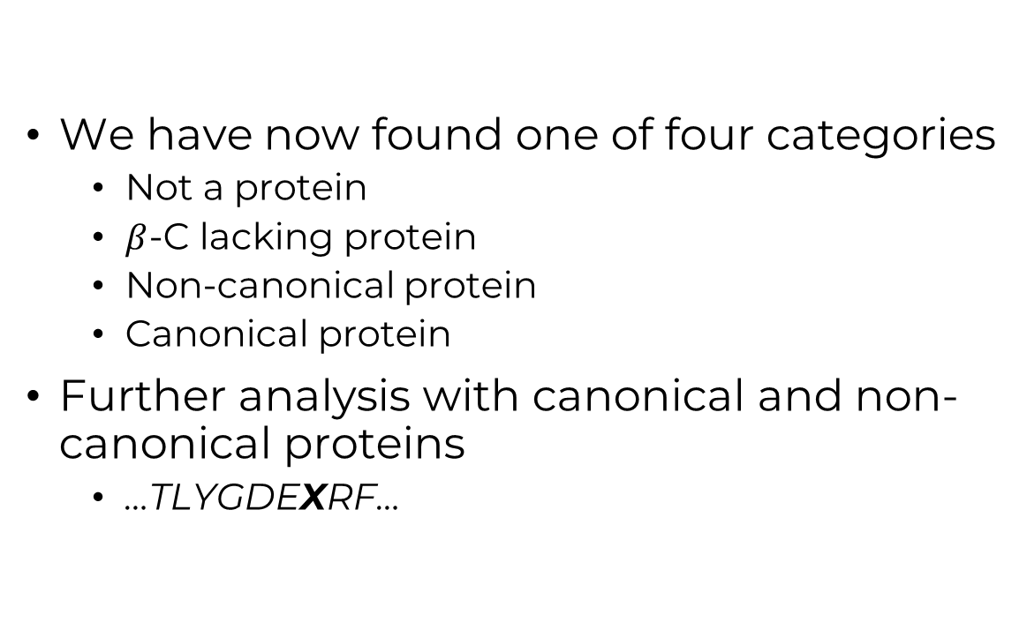
Atom-level evaluation
We have now found one of four categories
  Not a protein
  $β$-C lacking protein
  Non-canonical protein
  Canonical protein
Further analysis with canonical and non-canonical proteins
  …TLYGDEXRF…

Slide 37

Protein evaluation
Basic Local Alignment Search Tool (BLAST)¹
  Finds similar regions in sequences
  Diversity measured against the training set
  Uniqueness measured against generated proteins
Notes:
Basic Local Alignment Search Tool (BLAST) we can compare our amino acid sequences against databases
Finds regions in biological sequences that are similar
We can see how diverse our generated proteins are when we compare against the training set
We can see how unique our generate proteins are when we compare against our own generated proteins
Example image with difference between unique and diverse

Slide 38
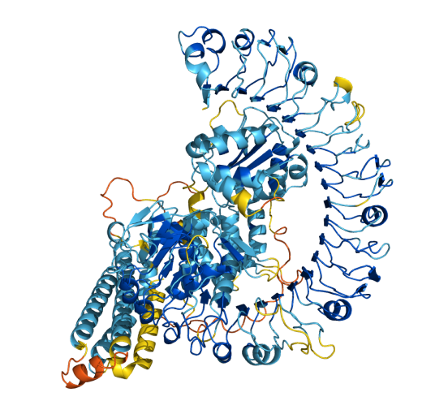
Protein evaluation
OmegaFold¹
  Sequence-to-structure model
  Assigns a confidence score (plDDT)
  Average over whole protein
Notes:
We use both canonical and non-canonical proteins
…TLYGDEXRF…
Basic Local Alignment Search Tool (BLAST) we can compare our amino acid sequences against databases
Finds regions in biological sequences that are similar
We can see how diverse our generated proteins are when we compare against the training set
We can see how unique our generate proteins are when we compare against our own generated proteins
Example image with difference between unique and diverse
See how structurally valid our sequence are using OmegaFold
OmegaFold protein sequence-to-structure model
Gives each amino acid in the protein a confidence score (plDDT)
Average this score to obtain an average plDDT for each sequence
Example image of a protein with different scores

Slide 39
Results
Quality, uniqueness, diversity & structure

Slide 40
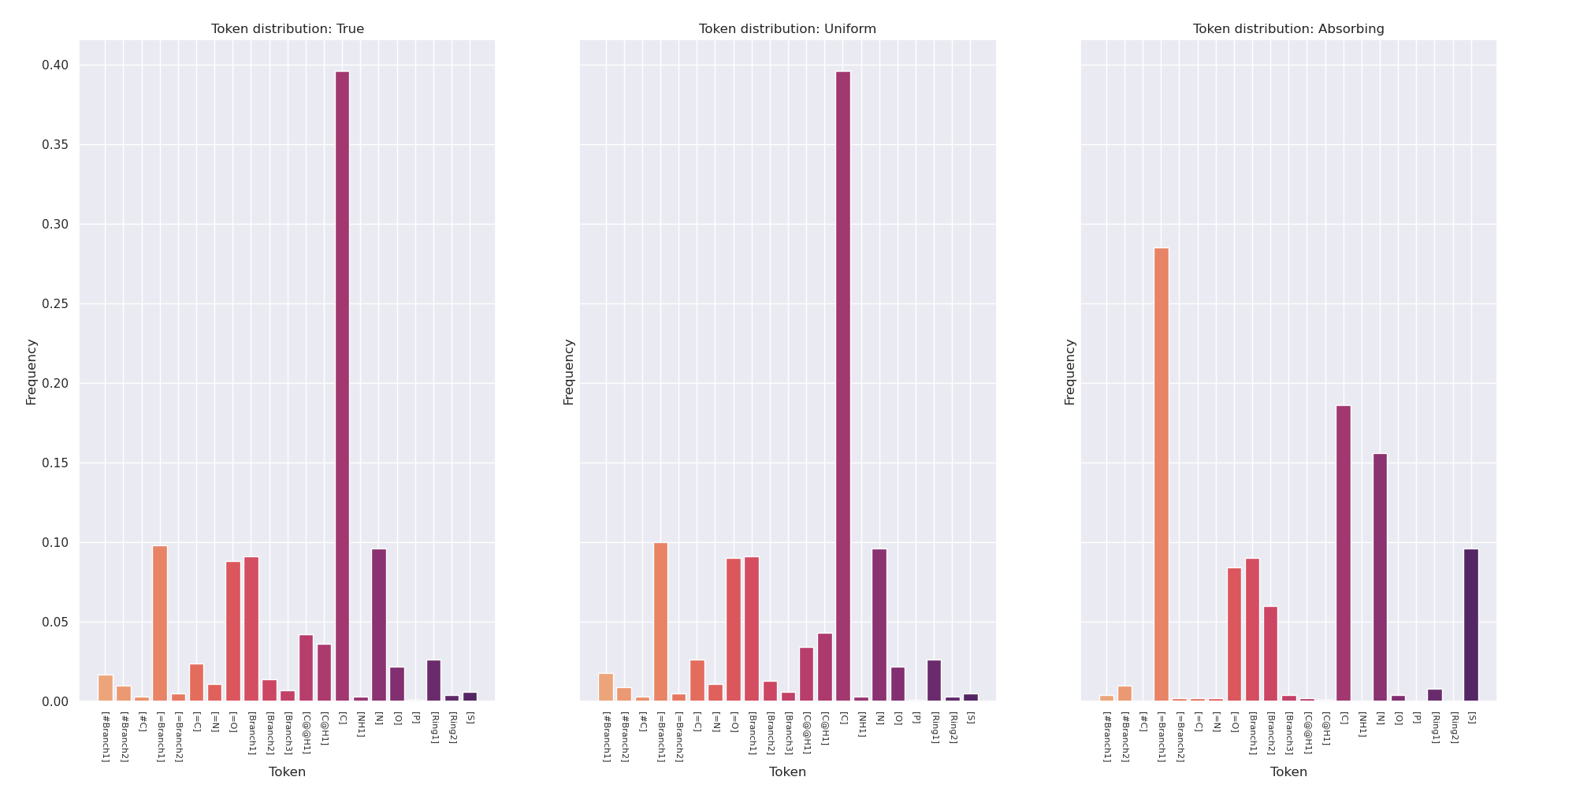

Slide 41
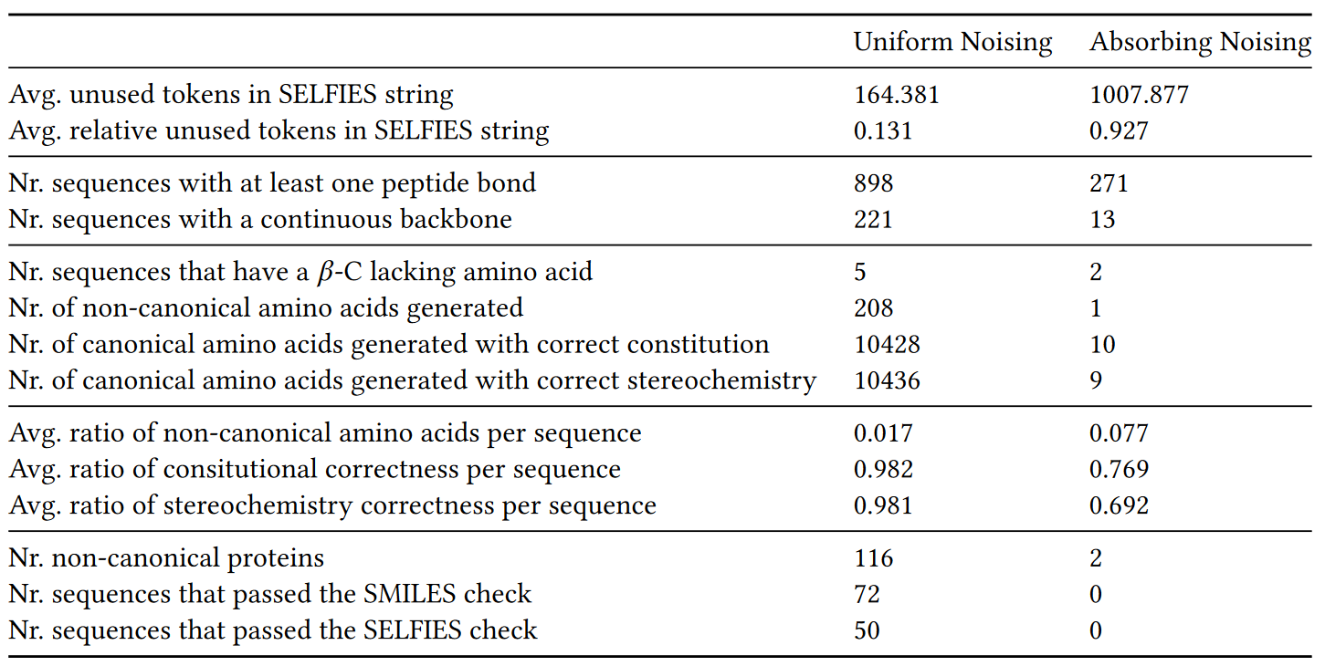

Slide 42
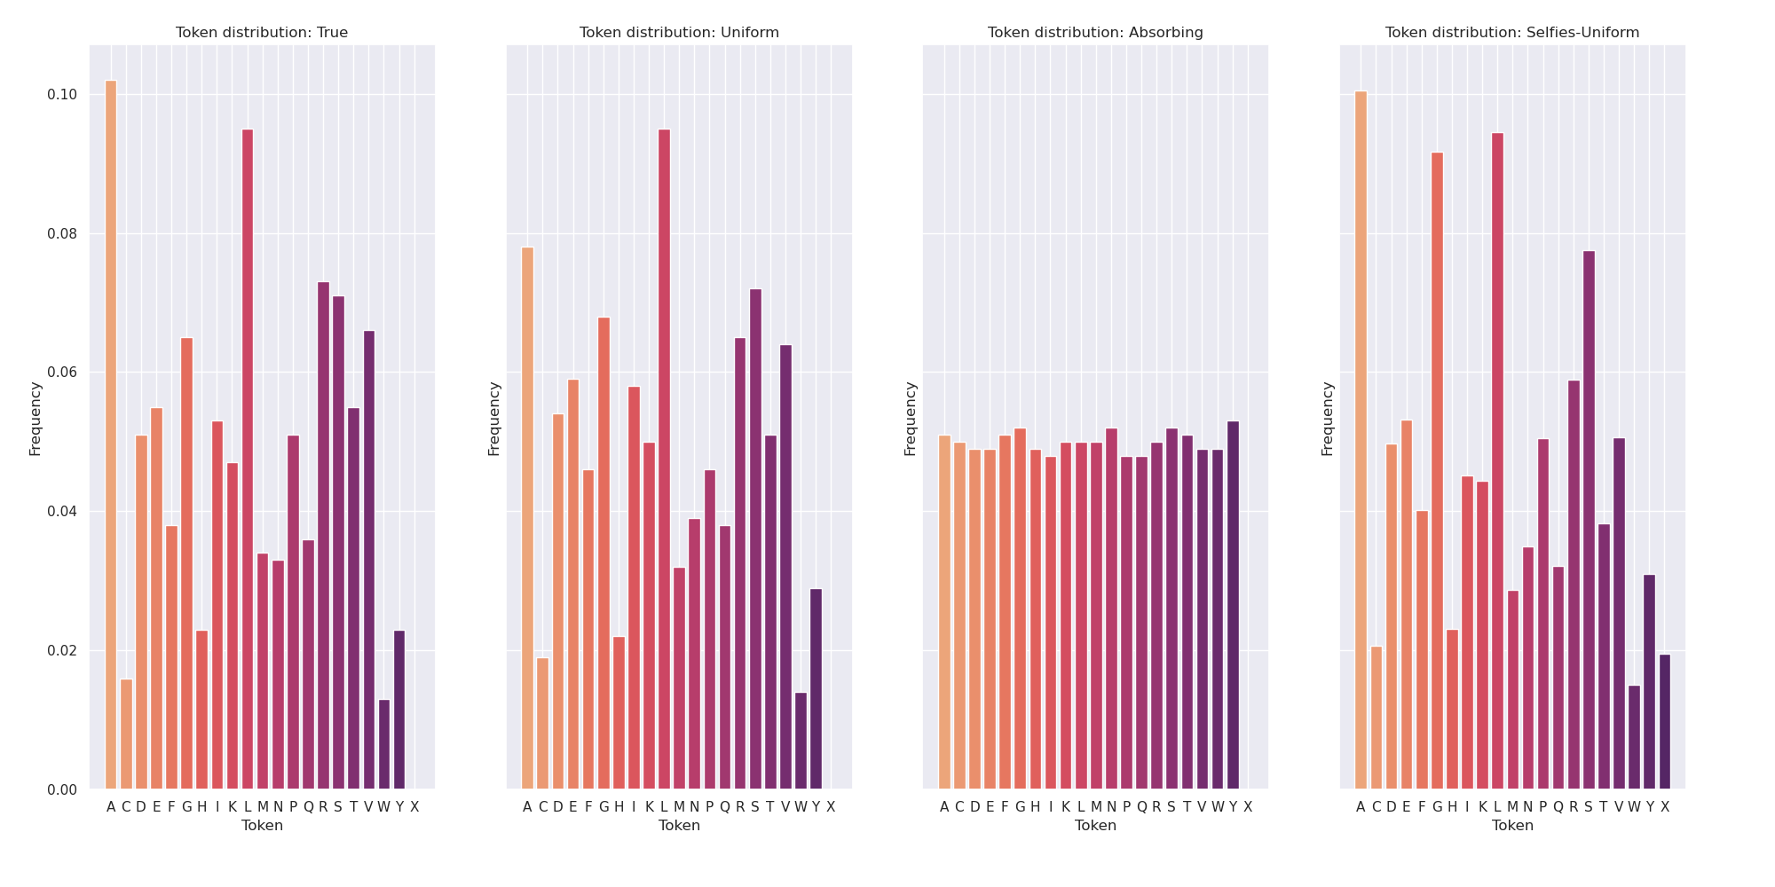

Slide 43
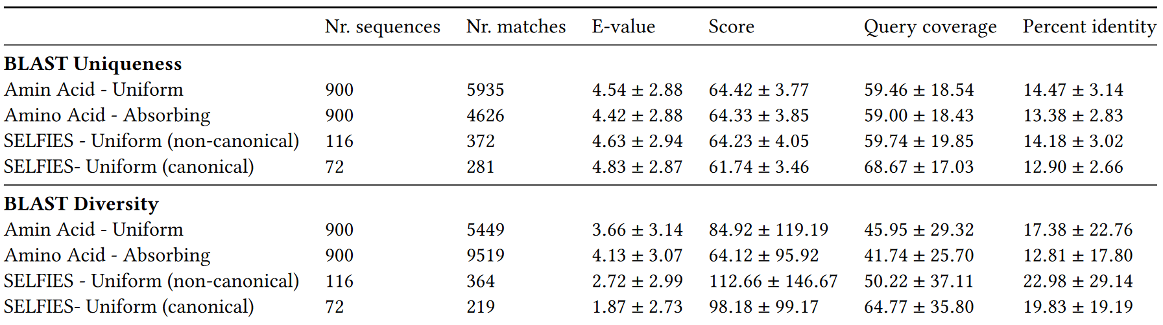

Slide 44
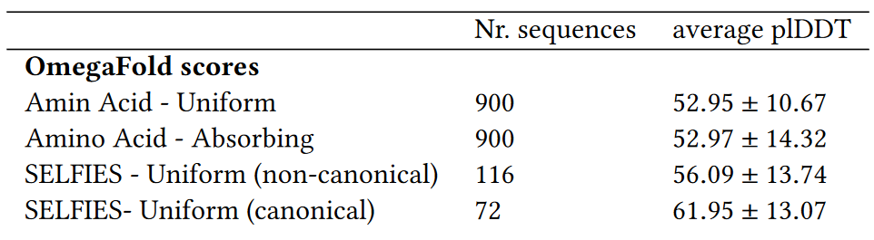
Notes:
Still nowhere near the recommended 70 for reliability

Slide 45
Conclusion
Able to generate proteins using an all-atom model
All-atom is less diverse, but structurally more sound
All-atom generates protein-like molecules
  Although few canonical proteins
The absorbing noise schedule has a negative impact on results
Notes:
Able to generate proteins using an all-atom model
All-atom is less diverse, comparable in uniqueness but structurally more sound
All-atom generates protein-like molecules
Although few canonical proteins
The absorbing noise schedule has a negative impact on results
Both atom-metrics and protein-metrics

Slide 46
Planning
Integrate feedback
Train the models longer
Improve the atom- & protein-level metrics
Investigate absorbing
Remaining two experiments
  Analysing different lengths
  Inpainting
Notes:
Inpainting is nice to have
Other stuff I want to definitely do

Slide 47
Questions?

